Slide 1
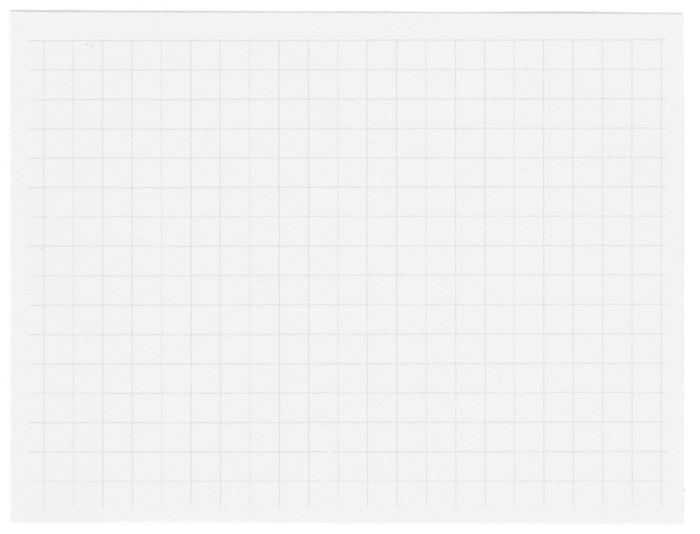













Stress Buster
Presented by Monolithic

Slide 2
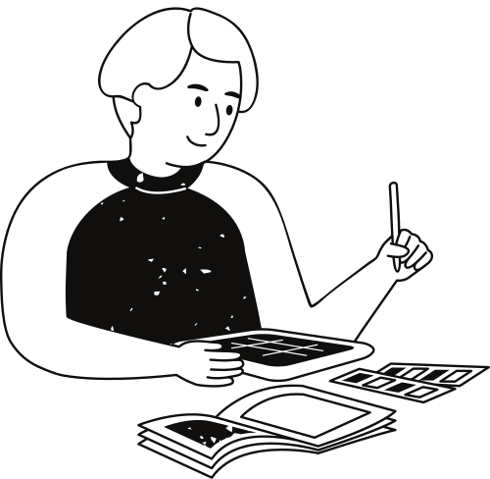
Origin of the creative idea
Stress Buster was created to address the common issue of stress. We saw a need for quick, personalized stress-relief solutions and combined AI mood tracking with activity suggestions to help users manage stress in real time.

Slide 3
01.
Stress Buster - AI Activity Suggestion App
Project vision and mission
Why Stress Buster?
02.
Stress affects millions globally, leading to health issues and reduced productivity.
Vision
03.
Provide personalized tools to help users manage stress effectively and lead healthier lives.

Slide 4
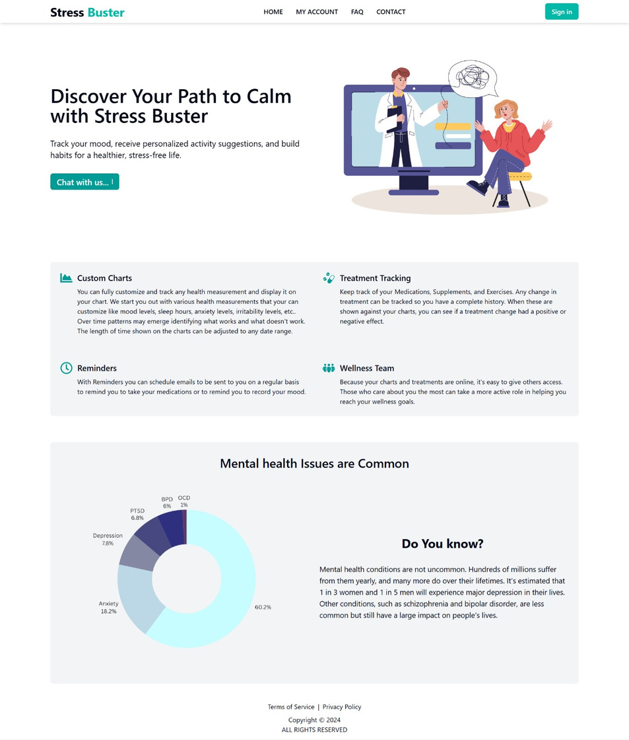
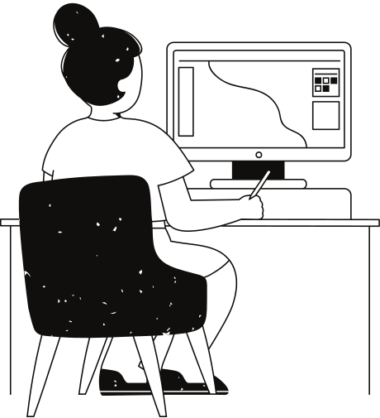
Inspiration and creativity

Slide 5
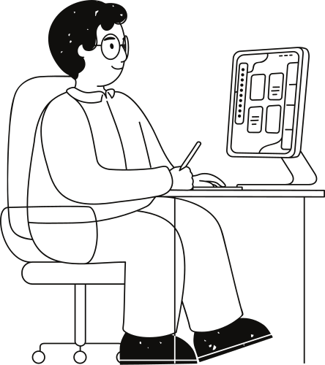
Creation process
Idea Formation: Identified the need for a simple, AI-powered stress management app.
Research: Explored existing wellness tools and AI capabilities.
Development: Built the app with React, Node.js, and Gemini AI for mood analysis and activity suggestions.
Testing: Focused on refining the user interface for simplicity and quick interaction.

Slide 6

Final reflections and future steps
Enhance AI mood analysis for deeper insights.
Add wearable device integration for more personalized data.

Slide 7
Thank you very much!

